Slide 1
Waiting-Line Models
D
MODULE
NOTE: Queue = Waiting Line

Slide 2
Outline
Queuing Theory
Characteristics of a Waiting-Line System
Queuing Costs
The Variety of Queuing Models
Other Queuing Approaches

Slide 3
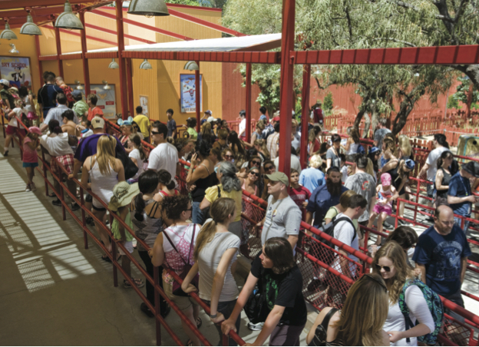
Queuing Theory
The study of waiting lines
Waiting lines are common situations
Occur in
Manufacturing
Service
This is a customer facing operation
Product many times judged based on waiting

Slide 4
Common Queuing Situations
TABLE D.1 | Common Queuing Situations
SITUATION |  | ARRIVALS IN QUEUE | SERVICE PROCESS
Supermarket |  | Grocery shoppers | Checkout clerks at cash register
Highway toll booth |  | Automobiles | Collection of tolls at booth
Doctor’s office |  | Patients | Treatment by doctors and nurses
Computer system |  | Programs to be run | Computer processes jobs
Telephone company |  | Callers | Switching equipment forwards calls
Bank |  | Customer | Transactions handled by teller
Machine maintenance |  | Broken machines | Repair people fix machines
Harbor |  | Ships and barges | Dock workers load and unload

Slide 5
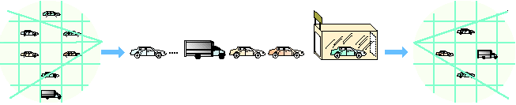
Parts of a Waiting Line
Population of
dirty cars
Arrivals
from the
general
population …
Queue
(waiting line)
Service
facility
Exit the system
Dave’s
Car Wash
Enter
Exit
Arrivals to the system
In the system
Exit the system
Figure D.1

Slide 6
Arrival Characteristics
Size of the arrival population
Unlimited (infinite) or limited (finite)
Pattern of arrivals
Scheduled or random, often a Poisson distribution
Constant and known rate independent of other events
Behavior of arrivals
Wait in the queue and do not switch lines
No balking or reneging

Slide 7
Waiting-Line Characteristics
Queue length
Limited or unlimited
Queue discipline
First-in, first-out (FIFO) is most common
Priority rules
For example: Hospitals us a triage system

Slide 8
Service Characteristics
Queuing system designs
Single-server system, multiple-server system
Single-phase system, multiphase system
Service time distribution
Constant service time
Random service times
Statistical distribution of service
Service rate
Where, when, and how much
Service costs

Slide 9
Queuing System Designs
A family dentist's office
Queue
Arrivals
Service facility
Departures
after service
Single-server, single-phase system
A fast-food, dual-window drive-through
Queue
Arrivals
Phase 1 service facility
Phase 2 service facility
Departures
after service
Single-server, multiphase system
Figure D.3

Slide 10
Queuing System Designs
Most bank and post office service windows
Service facility
Channel 1
Queue
Arrivals
Service facility
Channel 2
Departures
after service
Service facility
Channel 3
Multi-server, single-phase system – One channel handles all actions
Figure D.3

Slide 11
Queuing System Designs
Some college cafeterias
Phase 1 service facility
Channel 1
Phase 2 service facility
Channel 1
Queue
Arrivals
Departures
after service
Phase 1 service facility
Channel 2
Phase 2 service facility
Channel 2
Multi-server, multiphase system – Different phases can specialize
Figure D.3

Slide 12
Other Queuing Approaches
The single-phase models cover many queuing situations
Variations of the four single-phase systems are possible
Multiphase models exist for more complex situations

Slide 13
Queue Performance Variables
Arrival rate (λ)
Service rate (μ)
Number of servers
Server cost ($/time)
Waiting cost ($/time)
Based on lost customers who balk or renege
Average server utilization (ρ)
Average queue length/number (L_{q})
Average system length/number (L_{s})
Average time in queue (W_{q})
Average time in system (W_{s})
Probability service facility will be idle (P₀)%
Cost of waiting
Cost of system
Probability of a specific number of customers in the system
= Probability of more than k units in the system, where n is the number of units in the system
Calculated using ExcelOM
P_{n>k} =

Slide 14
Queuing Costs
Cost
Minimum
Total
cost
Total expected cost
Cost of providing service
Cost of waiting time
Low level
of service
Optimal
service level
High level
of service
Figure D.5

Slide 15
Queuing Models
The four queuing models that follow all assume:
Poisson distribution arrivals
FIFO discipline
A single-service phase

Slide 16
Queuing Models
MODEL | NAME | EXAMPLE | NUMBER OF SERVERS (CHANNELS) | NUMBER OF PHASES | ARRIVAL RATE PATTERN | SERVICE TIME PATTERN | POPULATION SIZE
A | Single-server system (M/M/1) | Information counter at department store | Single | Single | Poisson | Negative exponential | Unlimited
B | Multiple-server (M/M/S) | Airline ticket counter | Multi-server | Single | Poisson | Negative exponential | Unlimited
C | Constant-service (M/D/1) | Automated car wash | Single | Single | Poisson | Constant | Unlimited
D | Finite population (M/M/1 with finite source) | Shop with only a dozen machines that might break | Single | Single | Poisson | Negative exponential | Limited
All assume FIFO

Slide 17
Types of Queues
What type of queuing model might be used for the following examples?
Wal-Mart checkout
Environmental consulting company
Car assembly line
Doctor’s office – No emergencies
Doctor’s office – with emergencies
Traffic jam
A photographer taking individual pictures for a sports team

Slide 18
Types of Queues
What type of queuing model might be used for the following examples?
Wal-Mart checkout: A or B
Environmental consulting company: B
Car assembly line: C
Doctor’s office – No emergencies: A
Doctor’s office – With emergencies: B
Traffic jam: A, B, or C
A photographer taking individual pictures for a sports team: D

Slide 19
Model A – Single-Server
Arrivals are served on a FIFO basis
Every arrival waits to be served regardless of the length of the queue
Arrivals are independent of preceding arrivals
Average number of arrivals does not change over time
Arrivals are described by a Poisson probability distribution
Come from an infinite population
Service times vary from one customer to the next and are independent of one another
But average rate is known
Service times occur according to the negative exponential distribution
The service rate is faster than the arrival rate

Slide 20
Model A – Single-Server
TABLE D.3 |  | Queuing Information for Model A: Single-Server System, M/M/1
λ | = average number of arrivals per time period
μ | = average number of people or items served per time period (average service rate)
L_{s} | = average number of units (customers) in the system (waiting and being served)
W_{s} | = average time a unit spends in the system (waiting time plus service time)
L_{q} | = average number of units waiting in the queue
W_{q} | = average time a unit spends waiting in the queue
Ρ | = utilization factor for the system:
P₀ | = Probability of 0 units in the system (that is, the service unit is idle)
P_{n>k} | = probability of more than k units in the system, where n is the number of units in the system
NOTE: For reference, equations can be found in the book

Slide 21
Single-Server Example
A car mechanic has the following data:
λ = 2 cars arriving/hour; µ= 3 cars serviced/hour
What is the average number of cars in the system?
What is the average wait time?
What is the average number of cars waiting in the queue?

Slide 22
Single-Server Example
A car mechanic has the following data:
λ = 2 cars arriving/hour; µ= 3 cars serviced/hour
What is the average number of cars in the system?
What is the average wait time?
What is the average number of cars waiting in the queue?

Slide 23
Single-Server Example (cont)
A car mechanic has the following data:
λ = 2 cars arriving/hour; µ= 3 cars serviced/hour
What is the average number of cars in the system?
What is the average wait time?
What is the average number of cars waiting in the queue?
What is the average time to wait in the queue?
What is the probability the mechanic is busy?
What is the probability there are no cars waiting or being serviced?

Slide 24
Single-Server Example (cont)
A car mechanic has the following data:
λ = 2 cars arriving/hour; µ= 3 cars serviced/hour
What is the average number of cars in the system?
What is the average wait time?
What is the average number of cars waiting in the queue?
What is the average time to wait in the queue?
What is the probability the mechanic is busy?
What is the probability there are no cars waiting or being serviced?
W_{q} = 2/3 hour = 40 minute average waiting time
ρ = 67% of time mechanic is busy
P₀ = 33% probability there are 0 cars in the system

Slide 25
Single-Server Example Cost
The car mechanic has estimated the following cost data:
Customer dissatisfaction and lost goodwill = $15 per hr
Mechanic's salary = $88 per day
What is the cost, per day, to the mechanic for people to wait in the queue?
What is the total cost, per day, including servicing?

Slide 26
Single-Server Example Cost
The car mechanic has estimated the following cost data:
Customer dissatisfaction and lost goodwill = $15 per hr
Mechanic's salary = $88 per day
What is the cost, per day, to the mechanic for people to wait in the queue?
What is the total cost, per day, including servicing?
Total expected waiting costs = $248 per day
Total system costs = $328 per day

Slide 27
Multiple-Server Model
TABLE D.4
Additional Queuing Information for Model B: Multiple-Server System, also Called M/M/S
M = number of servers (channels) open

Slide 28
Multiple-Server Example
The car mechanic has the same data as before; however, the shop now has 2 mechanics.
λ = 2 cars arriving/hour; µ = 3 cars serviced/hour
What is the average number of cars in the system?
What is the average wait time?
What is the average number of cars waiting in the queue?

Slide 29
Multiple-Server Example
The car mechanic has the same data as before; however, the shop now has 2 mechanics.
λ = 2 cars arriving/hour; µ = 3 cars serviced/hour
What is the average number of cars in the system?
What is the average wait time?
What is the average number of cars waiting in the queue?

Slide 30
Multiple-Server Example (cont)
The car mechanic has the same data as before; however, the shop now has 2 mechanics.
λ = 2 cars arriving/hour µ = 3 cars serviced/hour
What is the average number of cars in the system?
What is the average wait time?
What is the average number of cars waiting in the queue?
What is the average time to wait in the queue?
What is the probability the mechanic is busy?
What is the probability there are no cars waiting or being serviced?

Slide 31
Multiple-Server Example (cont)
The car mechanic has the same data as before; however, the shop now has 2 mechanics.
λ = 2 cars arriving/hour µ = 3 cars serviced/hour
What is the average number of cars in the system?
What is the average wait time?
What is the average number of cars waiting in the queue?
What is the average time to wait in the queue?
What is the probability the mechanic is busy?
What is the probability there are no cars waiting or being serviced?
W_{q} = 0.04x60 = 2.5 minute average waiting time
ρ = 33% of time mechanic is busy
P₀ = 50% probability there are 0 cars in the system

Slide 32
Multiple-Server Example Cost
The car mechanic has estimated the following cost data:
Customer dissatisfaction and lost goodwill = $15 per hr
Mechanic's salary = $88 per day
What is the cost, per day, to the mechanic for people to wait in the queue?
What is the total cost, per day, including servicing?

Slide 33
Multiple-Server Example Cost
The car mechanic has estimated the following cost data:
Customer dissatisfaction and lost goodwill = $15 per hr
Mechanic's salary = $88 per day
What is the cost, per day, to the mechanic for people to wait in the queue?
What is the total cost, per day, including servicing?
Total expected waiting costs = $186 per day
Total system costs = $266 per day

Slide 34
Examples Comparison
Metric | One Mechanic | Two Mechanics
Server Utilization (ρ) | 67% | 33%
System Empty (P₀) | 33% | 50%
Length Queue (L_{q}) | 1.33 cars | 0.08 cars
Length system (L_{s}) | 2.00 cars | 0.75 cars
Time Queue (W_{q}) | 40 minutes | 3 minutes
Time System (W_{s}) | 60 minutes | 23 minutes
Cost Waiting | $248 | $186
Cost System | $328 | $266
Which model is better?

Slide 35
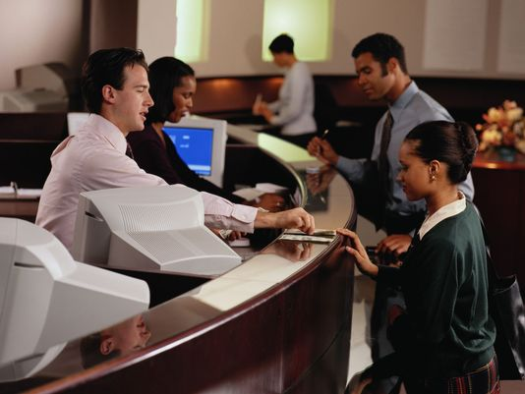
Waiting-Line Table Example
A bank has the following queuing information for how fast bank tellers process customers
= 18, µ = 20
Calculate the queue time for 1, 2, 3, and 4 tellers

Slide 36
Waiting-Line Table Example
A bank has the following queuing information for how fast bank tellers process customers
= 18, µ = 20
Calculate the queue time for 1, 2, 3, and 4 tellers
NUMBER OF SERVERS | M | NUMBER IN QUEUE | TIME IN QUEUE
1 window | 1 | 8.100 | .45 hrs, 27 minutes
2 windows | 2 | 0.229 | .0127 hrs, 46 seconds
3 windows | 3 | 0.030 | .0017 hrs, 6 seconds
4 windows | 4 | 0.004 | .0002 hrs, <1 second

Slide 37
Constant-Service-Time Example
Trucks currently wait 15 minutes on average
Truck and driver cost $60 per hour
Automated compactor service rate (µ) = 12 trucks per hour
Arrival rate (λ) = 8 per hour
Compactor costs $3 per truck
Complete the table below.
 | Constant Service
P₀
L_{s}
W_{s}
L_{q}
W_{q}
System Cost

Slide 38
Constant-Service-Time Example
Trucks currently wait 15 minutes on average
Truck and driver cost $60 per hour
Automated compactor service rate (µ) = 12 trucks per hour
Arrival rate (λ) = 8 per hour
Compactor costs $3 per truck
Complete the table below.
Current waiting cost per trip = (1/4 hr)($60) = $15 /trip
 | Constant Service
P₀ | 33%
L_{s} | 1.33
W_{s} | 10.0 min
L_{q} | 0.67
W_{q} | 5.0 min
System Cost | $23.00

Slide 39
Finite-Population Model
Assumptions
There is only one server
The population of units seeking service is finite
Arrivals follow a Poisson distribution
Customers are served on a first-come, first-served basis

Slide 40
Finite-Population Example
Laser printer breakdown analysis
# = 5, λ = 0.05 printers/hour, μ = 0.50 printers/hour
Complete the data below.
P₀ =
L_{q} =
L_{s} =
W_{q} =
W_{s} =

Slide 41
Finite-Population Example
Laser printer breakdown analysis
# = 5, λ = 0.05 printers/hour, μ = 0.50 printers/hour
Complete the data below.
P₀ = 56%
L_{q} = 0.2 printers
L_{s} = 0.64 printers
W_{q} = 0.93 hours
W_{s} = 2.93 hours

Slide 42
Finite-Population Example
For the previous situation, the company wants to know how much the printer servicing is costing the company per hour.
L_{s} = 0.64 printers
Alternative printing methods cost per hour = $120
Technician cost per hour = $25
Hourly cost computed as below:
(Units in system)(Downtime cost) + Service cost
Hourly cost = (Average number of printers down)(Cost per downtime hour) + Cost per technician hour
= (0.64)($120) + $25
= $76.80 + $25.00
= $101.80 per hour

Slide 43
Advanced Problem
Use data below to determine how many sales people the company should hire.
Average of 60 customers per shift
Average waiting times
One salesperson = 14 minutes
Two salespeople = 8 minutes
Three salespeople = 4 minutes
Four salespeople = 3 minutes
Cost per minute that customers wait at ​$1.25
Cost per salesperson per shift​ (including fringe​ benefits) is ​$95
One​ Server: Total cost per shift​ = $___
Two​ Servers: Total cost per shift​ = $___
Three​ Servers: Total cost per shift​ = $___
Four​ Servers: Total cost per shift​ = $___
Hire _ salespeople.

Slide 44
Advanced Problem
Use data below to determine how many sales people the company should hire.
Average of 60 customers per shift
Average waiting times
One salesperson = 14 minutes
Two salespeople = 8 minutes
Three salespeople = 4 minutes
Four salespeople = 3 minutes
Cost per minute that customers wait at ​$1.25
Cost per salesperson per shift​ (including fringe​ benefits) is ​$95
One​ Server: Total cost per shift​ = $1,145
Two​ Servers: Total cost per shift​ = $790
Three​ Servers: Total cost per shift​ = $585
Four​ Servers: Total cost per shift​ = $605
Hire 3 salespeople.

